Slide 1
WNM 617
Bootstrap – Part 2

Slide 2
Bootstrap Part 2
Introduction, Setup, CSS

Slide 3
Grid System
Bootstrap includes a responsive, mobile first fluid grid system
The grid system can have up to 12 columns

Slide 4
Grid Continued
The Bootstrap grid system has some rules we must follow.
All rows must be placed in the .container or .container-fluid element to get padding
We use rows to create columns
Content is placed within columns
Predefined classes such as .row and .col-xx-x are available for quickly creating grids
Grid colums are created by specifying the number of twelve available columns you wish to span
EG. .col-xs-4 would give us three equally sized columns

Slide 5
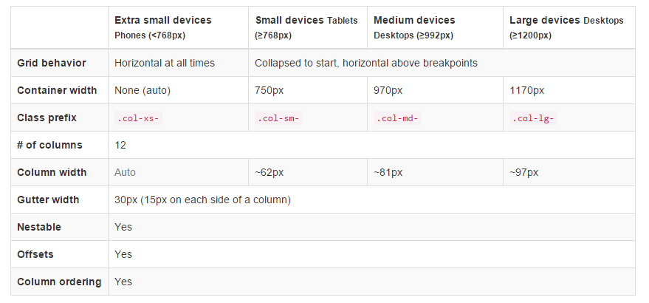
Grid Continued
Grid classes apply to devices with screen widths greater than or equal to the breakpoint sizes, and override grid classes targeted at smaller devices. Therefore, e.g. applying any .col-md-* class to an element will not only affect its styling on medium devices but also on large devices if a .col-lg-* class is not present.

Slide 6
Grid Continued
DEMO

Slide 7
More CSS
Typography, Body Copy, Forms, Buttons, Images

Slide 8
Typography and Body Copy
Bootstrap uses a default font for all HTML components and body content
http://getbootstrap.com/css/#type

Slide 9
Forms
Form controls get some basic styling from bootstrap
All textual <input>, <textarea>, and <select> elements with .form-control are set to width: 100%; by default. Wrap labels and controls in .form-group for optimum spacing.
Add .form-inline to your form for left-aligned and inline-block controls
Use the Grid to align form controls and labels
Demo

Slide 10
Buttons
Button CSS classes can be used on <a>, <button>, and <input> HTML elements
Button classes include
btn
btn-default
btn-primary
btn-success
btn-info
btn-warning
btn-danger
btn-link
btn-lg, btn-sm, btn-xs

Slide 11
Images
To make an image responsive add the class img-responsive to its img tag
To change the shape of an image use classes
img-rounded
img-circle
img-thumbnail

Slide 12
Components
Glyphs and Navigation

Slide 13
Glyphs and Nav
http://getbootstrap.com/components/

Slide 14
Customizing
Editing CSS and using the Tool

Slide 15
Customizing
If you need custom CSS and you have downloaded the CSS files for bootstrap you can edit them directly
Another option is to use the tool Bootstrap provides
http://getbootstrap.com/customize

Slide 16
Next Week
Bootstrap JavaScript
Hybrid App Design and Development Introduction
Final Project Introduction and Ideation

Slide 17
Activity
Reverse Ideas
Midpoint Presentations
Work on homework

